Slide 1
Developing With MySQL

Slide 2
C/S

Slide 4
--protocol
  tcp, socket, pipe, memory
B
C
web
S
S
S

Slide 5
Data type
  修饰
SQL
  database
  table
  index
  view
  SELECT, UPDATE, INSERT, DELETE
  SUBquery, join

Slide 6
Agenda
MySQL data types
MySQL Language Structure

Slide 7
Data Type
Each data type has several characteristics:
  What kind of values it can represent
  How much space values take up
  Whether values are fixed-length (all values of the type take the same amount of space) or variable-length (the amount of space depends on the particular value being stored)
  How MySQL compares and sorts values of the type
  Whether the type can be indexed

Slide 8
Data types overview
In order to store, retrieve, or process data, the data must be assigned a data type
MySQL includes many of the ISO SQL:2003 standard data types, and adds in more data types
  Character String Types
  Binary Large Object String Types
  Numeric Types
  Boolean Types
  Datetime Types
  Internal Types

Slide 9
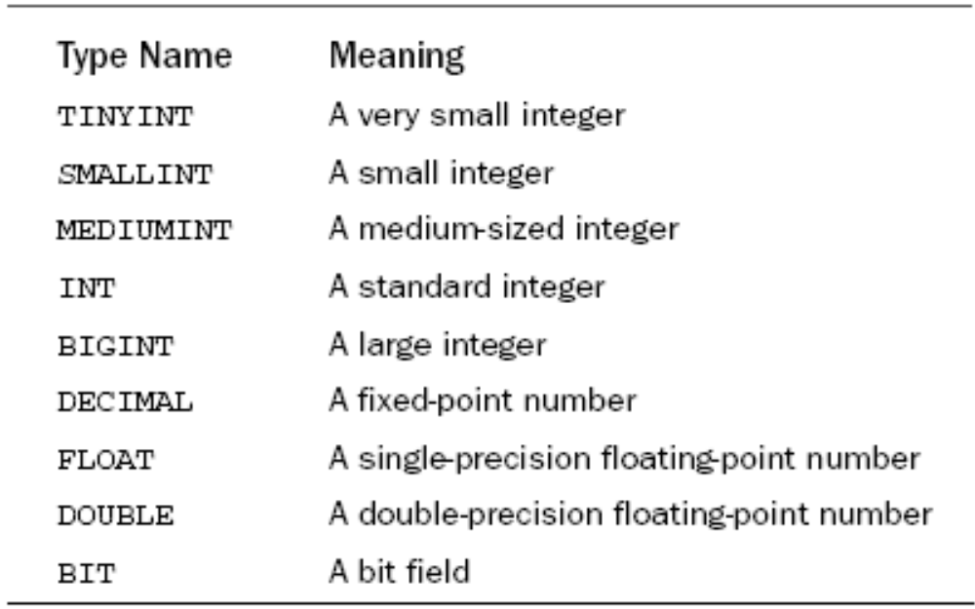
Overview of Data Types
Numeric Data Types

Slide 10
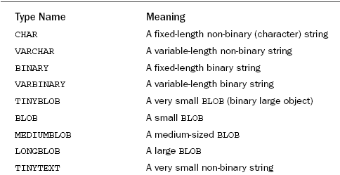
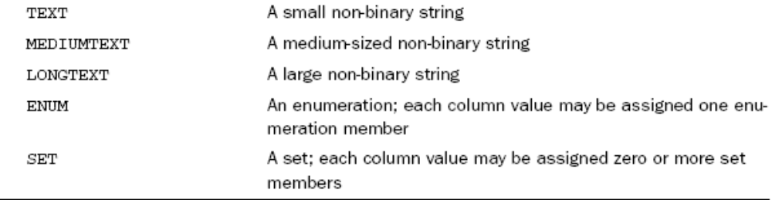
String Data Types

Slide 11
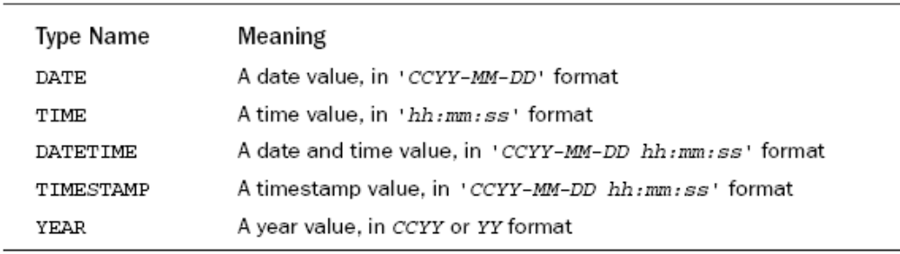
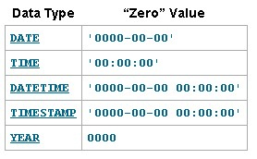
Date and Time Data Types

Slide 12
String Data Types
The ISO SQL:2003 standard defines three character string types
Each string type has more than one keyword associated with it
Fixed-width strings:
  CHARACTER(length)
  CHAR(length)
Variable-length strings:
  CHARACTER VARYING(length)
  CHAR VARYING(length)
  VARCHAR(length)

Slide 13
MySQL specific string types
MySQL also supports the following nonstandard string types:
  TINYTEXT
  TEXT
  MEDIUMTEXT
  LONGTEXT
Unlike most data types, the four TEXT data type fields are objects separate from the containing table or result set
They are queried as regular fields are, but behind the scenes they are not actually stored in the table, they are stored as separate objects

Slide 14
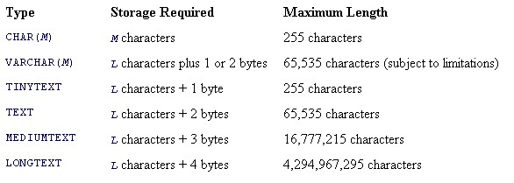
length of string types
The CHAR and VARCHAR data types require a length argument
A data type of CHAR or VARCHAR with a length of 0 is valid, but can hold only two values: the empty string and NULL

Slide 15
Character string type attributes
NOT NULL —By default, NULL values are allowed. To disallow NULL values, use the NOT NULL attribute
NULL —The NULL attribute is shorthand for DEFAULT NULL
DEFAULT —The DEFAULT attribute is valid for CHAR and VARCHAR only; it is not valid for any of the TEXT data types. The DEFAULT attribute causes a character string to have a default value when a value is not specified

Slide 16
CHARACTER SET —The CHARACTER SET attribute causes a character string to be stored in the specified character set If no value is specified, the default character set is used
  ASCII—An alias for CHARACTER SET latin1
  UNICODE—An alias for CHARACTER SET ucs2
COLLATION —The COLLATION attribute causes a character string to be stored, indexed, and ordered according to the specified collation

Slide 17
National Character String Types
Three national character string types are defined by the ISO SQL:2003 standard. Each string type has more than one keyword associated with it
MySQL supports the SQL standard for fixed- and variable-length strings, but not for character objects

Slide 18
Binary Large Object String Types
MySQL supports only the standard syntax, BLOB(length)
MySQL extends the SQL standard for binary large object string types with five additional binary types:
  TINYBLOB
  MEDIUMBLOB
  LONGBLOB
  BLOB
  BINARY(length)
  VARBINARY(length)
Binary string types are byte strings. Character strings are ordered lexically; binary strings are ordered by each byte’s value

Slide 19
BLOB values
TINYBLOB— Up to 255 bytes, 1 byte overhead
BLOB—Up to 64 Kb, 2 bytes overhead
MEDIUMBLOB—Up to 16 Mb, 3 bytes overhead
LONGBLOB— Up to 4 Gb, 4 bytes overhead

Slide 20
BINARY length
The length of BINARY is an integer from 0–255
If a string is stored as a BINARY and is smaller than the length, binary spaces (represented by \0) are appended to the string

Slide 21
VARBINARY length
The maximum length of a VARBINARY is restricted only by the maximum row length.
In most storage engines, the maximum row length is the maximum allowed by MySQL, which is 65,535 bytes.

Slide 22
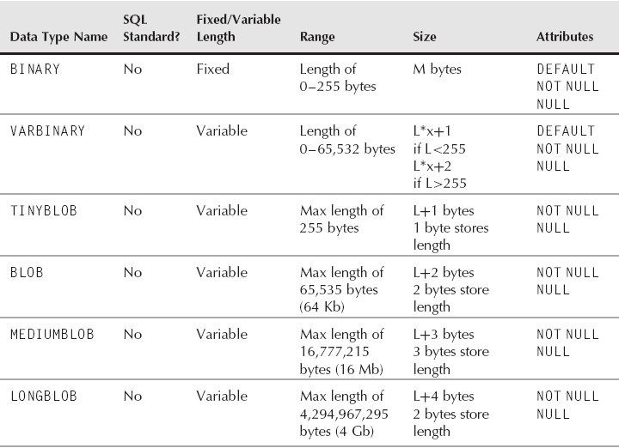
Summary of MySQL Binary Data Types

Slide 23
Numeric Types
Exact numeric type:
  NUMERIC(g,f)
  DECIMAL(g,f) can be abbreviated as DEC
  TinyINT
  SMALLINT
  MEDIUMINT
  INTEGER can be abbreviated as INT
  BIGINT
Approximate numeric type:
  FLOAT(p)
  REAL
  DOUBLE

Slide 24
The standard SQL has been extended to add these additional numeric data types:
Exact numeric types:
  TINYINT
  MEDIUMINT
  BIT(x)

Slide 25
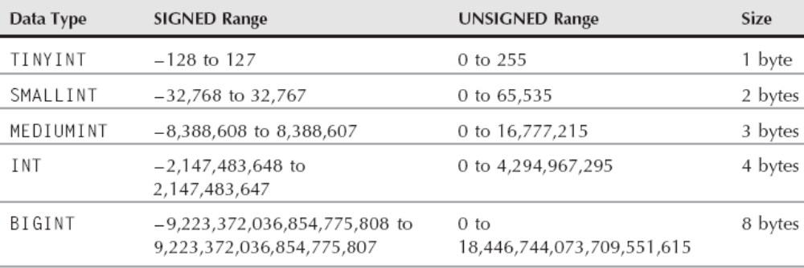
Data Sizes and Ranges for Integer Data Types

Slide 26
BIT size and range
The BIT data type stores integers as a series of bits
The range of a BIT field is determined by the argument to BIT(x)
The default range is 1 bit and the range can be set from 1 to 64 bits
The BIT values are stored in binary format
Unlike other data types, a BIT value needs to be converted upon retrieval to produce a human-readable result

Slide 27
Using the AUTO_INCREMENT Column Attribute
The AUTO_INCREMENT attribute may be added to an integer column definition to create a column for which MySQL automatically generates a new sequence number each time you create a new row.
There may be only one AUTO_INCREMENT column per table, the column must be indexed, and the column must be defined as NOT NULL
The AUTO_INCREMENT attribute is used in conjunction with an index (usually a primary key) and provides a mechanism whereby each value is a unique identifier that can be used to refer unambiguously to the row in which it occurs
MySQL also provides a LAST_INSERT_ID() function that returns the most recently generated AUTO_INCREMENT value

Slide 28
These declarations involve the following factors, which you should consider when creating an AUTO_INCREMENT column:
  The column must have an integer data type. Choose the specific type based on the number of values the column must be able to hold, Such as INT, BIGINT
  An AUTO_INCREMENT sequence contains only positive values. So it's best to declare the column to be UNSIGNED
  The most common way to use an AUTO_INCREMENT column is as a primary key, which ensures unique values and prevents duplicates. The column should thus be defined to contain unique values, either as a PRIMARY KEY or a UNIQUE index
  An AUTO_INCREMENT column must be NOT NULL

Slide 29
FLOAT size and range
The FLOAT data type is a single-precision floating-point number
Floating-point means that unlike the DECIMAL data type, the decimal point can be anywhere in the number — the decimal point floats
A FLOAT is limited in how many significant digits it can store
MySQL supports the SQL standard FLOAT(p) syntax
A FLOAT field can be defined as FLOAT(g,f)

Slide 30
DOUBLE size and range
The DOUBLE data type is a double-precision floating-point number
Like a FLOAT, a DOUBLE is limited in how many significant digits it can store
A DOUBLE field can be defined with no parameters as DOUBLE, or it can be defined as DOUBLE(g,f)
The DOUBLE(g,f) syntax can be used to override the default number of significant digits

Slide 31
Numeric data type attributes
NOT NULL—By default, NULL values are allowed
NULL—The NULL attribute is shorthand for DEFAULT NULL
DEFAULT—The DEFAULT attribute is valid for all numeric data types. If no DEFAULT value is specified, MySQL will create numeric data type fields as DEFAULT NULL
AUTO_INCREMENT—The AUTO_INCREMENT attribute is used to define a sequence as a default value for a field
  except for BIT and DECIMAL
  the field is converted to use the NOT NULL attribute
  can only be one AUTO_INCREMENT field per table
  By default, the sequence starts at 1 and increases by 1 for every insert. To change the number the sequence starts at, set the auto_increment_offset variable in the configuration file or set the dynamic session or global variable of the same name

Slide 32
UNSIGNED—The default range of numeric types includes 0, negative numbers, and positive numbers
SERIAL DEFAULT VALUE —The integer numeric types (TINYINT, SMALLINT, MEDIUMINT, INT, BIGINT) allow the SERIAL DEFAULT VALUE keyword. This is shorthand for NOT NULL AUTO_INCREMENT UNIQUE KEY

Slide 33
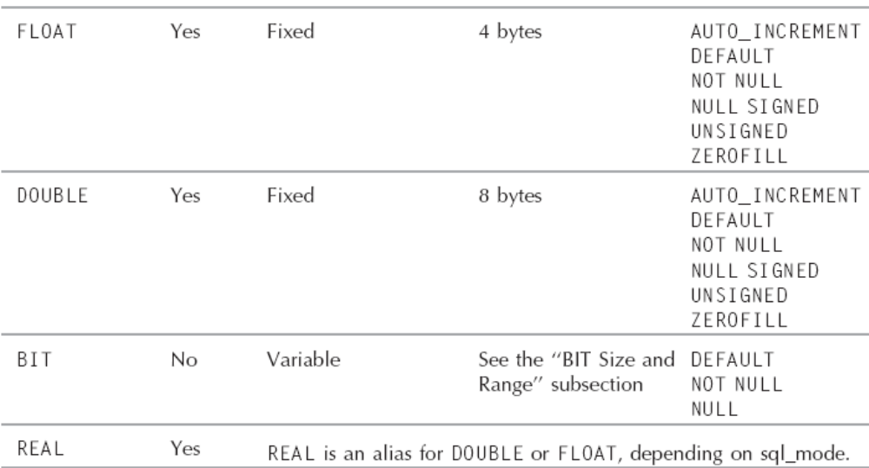

Slide 34
Boolean Types
MySQL implements BOOLEAN as an alias for TINYINT(1)
  BOOLEAN
  BOOL
  Bool
    1
    0

Slide 35
Datetime Types
DATE
TIME(p)
TIMESTAMP(p)
All these threes can specify the following attributes:
  WITH TIME ZONE
  WITHOUT TIME ZONE
YEAR
  The YEAR data type can be specified as YEAR(2) or YEAR(4)
DATETIME

Slide 36
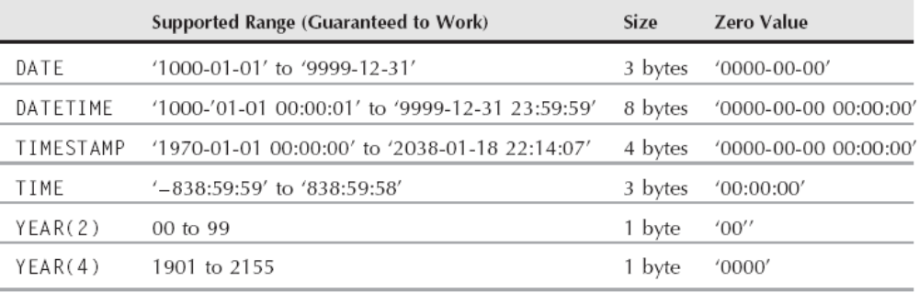
Datetime Data Types
Note that DATE and TIME each have 3 bytes, and together they can represent the same values using 6 bytes a DATETIME value can using 8 bytes

Slide 37
Datetime data type attributes
Not NULL
NULL
Default

Slide 38
The effect of time zones
The TIMESTAMP field is stored in UTC. When the value is stored, it is converted to UTC, using the mysqld system variable time_zone to figure out the proper value
When a TIMESTAMP value is retrieved, it is converted to the current time_zone of the mysqld server

Slide 39
ENUM and SET Types
MySQL adds in two data types that are very different from standard data types
  The ENUM data type is an enumerated list of 1 to 65,535 strings, which indicate the allowed values for the field
    Only one of the allowed values can be stored in an ENUM field
  The SET data type is an enumerated list of 1 to 64 strings, which indicate the allowed values for the field
    In the SET data type, any combination of the strings in the enumerated list can be stored as a comma-delimited list

Slide 40
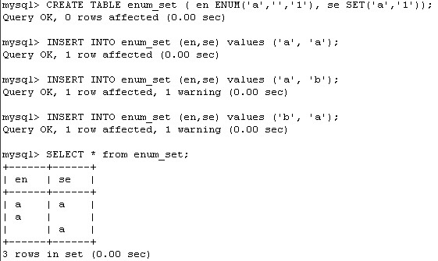
An example

Slide 41
the behavior of ENUM and SET fields
  ENUM and SET fields are defined with a limited set of strings. The index values of these strings start at 1 for the first string. Inserting a number that directly corresponds to the index value of the defined strings into an ENUM or SET field has the same result as inserting that string into a field
  The ENUM data type indexes its string values sequentially. The fifth value in the ENUM definition has an index value of 5. Inserting a number into an ENUM field that is greater than the largest index value of the defined strings is the same as inserting invalid data.
  The SET data type treats its string values as digits in a 64-bit binary value.
  To compare SET values, a bitwise comparison can be done. To find exact matches, use bitwise and (&). To find if one set is a subset of another, use bitwise or (|)

Slide 42
ENUM and SET data type attributes
NULL
NOT NULL
DEFAULT

Slide 43
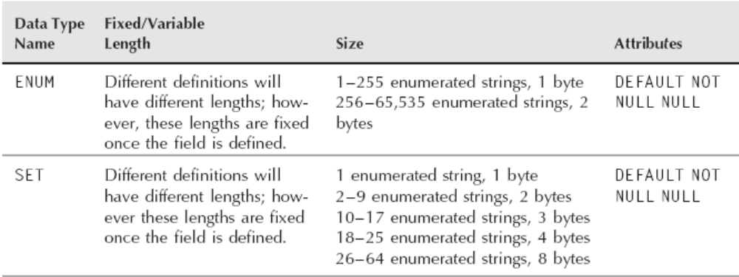
Summary of MySQL ENUM and SET Data Types

Slide 44
Choosing SQL Modes
For a long time, mysqld had automatically allowed inserting invalid data, truncating data, and more
Implicit data conversions were done by mysqld, often leading to unexpected data and data integrity problems
The sql_mode server variable can be set to change the default behavior of data validation and allowed SQL syntax

Slide 45
The value of the sql_mode server variable can be set on a global level with the sql_mode option to mysqld or the SET GLOBAL sql_mode=‘string’ command
The sql_mode server variable can be set per session with the SET SESSION sql_mode=string command. The string argument can be the empty string (’’), or a comma-separated list of one or more of the valid values
The list may not have any spaces between values
strict sql_mode means the sql_mode variable contains one or more of TRADITIONAL, STRICT_TRANS_TABLES, or STRICT_ALL_TABLES
The default global sql_mode is ’’ and the default session sql_mode is the global sql_mode

Slide 46
%
To see the value of the global server variable, use one of the following methods:
  SHOW GLOBAL VARIABLES LIKE ’sql_mode’;
  SELECT @@global.sql_mode;
  SELECT Variable_name, Variable_value FROM INFORMATION_SCHEMA.GLOBAL_VARIABLES WHERE Variable_name=’sql_mode’;
To see the value of the session server variable, use one of the following methods:
  SHOW SESSION VARIABLES LIKE ’sql_mode’;
  SELECT @@session.sql_mode;
  SELECT Variable_name, Variable_value FROM INFORMATION_SCHEMA.SESSION_VARIABLES WHERE Variable_name=’sql_mode’;

Slide 47
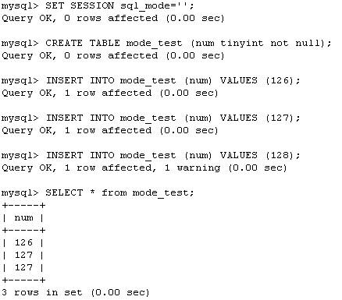
Invalid data
The most desired behavior of an sql_mode is the ability to change whether invalid data throws an error or simply a warning

Slide 48
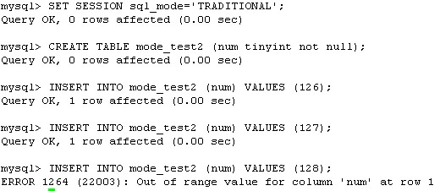
The inserted value that was too large for the field was truncated to the closest value that did fit in the field
Similarly, for string data, strings get truncated if they are too large. This behavior may or may not be desired; if it is not desired, set the appropriate sql_mode to throw an error:

Slide 49
The Server SQL Mode
Affects several aspects of SQL statement execution
  The SQL mode affects behaviors such as handling of invalid values during data entry and identifier quoting
  Can set by sql_mode
    SET sql_mode = 'TRADITIONAL';
    SET GLOBAL sql_mode = 'TRADITIONAL';
    SELECT @@SESSION.sql_mode;

Slide 50
DATABASE ()
Several SQL mode definitions
  ANSI QUOTES —A double quote (") is now treated as an identifier quote (`). Strings can only be quoted with a single quote (’)
  IGNORE_SPACE—This sql_mode allows a space between a built-in function and the open parenthesis
  STRICT_ALL_TABLES—When this sql_mode is not set, invalid data values are allowed, usually converted to valid data by using zero values or truncating the value. When this sql_mode is set, invalid data values are rejected, and an error is thrown.
  STRICT_TRANS_TABLES -- invalid data values in a transactional table are rejected, and an error is thrown
  TRADITIONAL— Syntax and behavior closely match traditional expectations

Slide 51
Case Sensitivity in SQL Statements
SQL keywords and function names
  Keywords and function names are not case sensitive
  They can be given in any lettercase
  SELECT, UPDATE, DATABASE()
Database, table, and view names
  MySQL represents databases and tables using directories and files in the underlying filesystem on the server host
Stored program names
  Stored function and procedure names and event names are not case sensitive
  Trigger names are case sensitive, which differs from standard SQL

Slide 52
Alias names
  The table aliases are case sensitive
String values
  Case sensitivity of a string value depends on whether it is a binary or non-binary string, and, for a non-binary string, on the collation of its character set

Slide 53
Database

Slide 54
Database
MySQL Server manages data by performing storage, retrieval, and manipulation of data records
Records are organized into tables, and tables are organized into databases
In MySQL, databases are stored in a common location called the "data directory."
Each MySQL server has a data directory under which it manages the contents of its databases
Another word for "database" is "schema."
  DATABASE = SCHEMA
  DATABASES= SCHEMAS

Slide 55
Creating Databases
Creating Databases
  CREATE DATABASE db_name;
If you try to create a database that already exists, an error occurs. The following can avoid error:
  CREATE DATABASE IF NOT EXISTS db_name;
The CREATE DATABASE statement has two optional clauses, CHARACTER SET and COLLATE, that assign a default character set and collation for the database. If given, they appear at the end of the statement following the database name:
  CREATE DATABASE db_name CHARACTER SET char_set COLLATE collate;
To make the new database the default database, issue a USE statement:
  USE db_name;
Notes:
SHOW CHARACTER SET

Slide 56
Altering Databases
The ALTER DATABASE statement changes options for an existing database. The allowable options are the same as for CREATE DATABASE; that is, CHARACTER SET and COLLATE:
  ALTER DATABASE db_name COLLATE collate;
  ALTER DATABASE db_name CHARACTER SET charset ;
If no database is named, the statement changes the options for the default database. This requires that there be a currently selected database. Otherwise, an error occurs
You cannot use ALTER DATABASE to rename a database

Slide 57
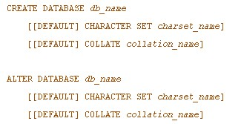
Summary of Creating and Altering database

Slide 58
Dropping Databases
When you no longer need a database, you can remove it with DROP DATABASE
  DROP DATABASE db_name;
It is an error if the database does not exist. To cause a warning instead, include an IF EXISTS clause:
  DROP DATABASE IF EXISTS db_name;
Any warning generated when IF EXISTS is used can be displayed with SHOW WARNINGS
DROP DATABASE does not require the database to be empty. Before dropping the database, MySQL removes any objects that it contains, such as tables, stored routines, and triggers

Slide 59
Tables and Indexes

Slide 60
Table Properties
Tables have both a logical and physical structure:
  Logically, each table in a database consists of rows and columns
    A table can be empty (it can have zero rows of data), but it must have at least one column
    A table may also be indexed to improve query performance
  Physically, each table is associated with one or more files on disk
    Every table has a format file in its database directory
      The format file is created by the server and contains the definition, or structure, of the table
      The format filename is the same as the table name, plus an .frm suffix

Slide 61
MySQL manages tables using storage engines, each of which handles tables that have a given set of characteristics
Different storage engines have differing performance characteristics, and you can choose which engine most closely matches the characteristics that you need, and you can make this choice on a per-table basis
Any given table is managed by a particular storage engine
In addition to the .frm file that the server creates, a table may be associated with one or more other files that the storage engine creates in which to store the table's contents
  The number and types of files vary per storage engine, because each engine manages table storage differently
    The MyISAM engine creates a data file and index file for each table
    By default, the InnoDB engine shares files for multiple tables

Slide 62
Data Directory
With respect to databases, the data directory has the following structure:
  The server represents each database using a subdirectory of the data directory. This subdirectory is called a "database directory."
  A database directory has the same name as the database that it represents
  MySQL uses the database directory to manage the components of the database such as:
    tables
    triggers
  Each database directory has a default character set and collation. You can specify these properties for a database when you create it. The properties are stored in a file named db.opt in the database directory
  Databases cannot be nested; one database cannot contain another

Slide 63

Creating Tables
MySQL provides several ways to create tables:
  You can create an empty table, either by specifying its definition explicitly or by using the definition of an existing table
  You can create a table populated from the result of a SELECT statement
  You can create temporary tables

Slide 64
Creating Tables Using an Explicit Definition
A new table can be created from an explicit definition by using a CREATE TABLE statement that includes the table name and a list of columns
Each column has its own name and definition
The table definition may also include index definitions
To create a table, give its name followed by a list of column definitions within parentheses:
  CREATE TABLE table_name (column_definitions);

Slide 65
Every table must belong to a database
That is, you cannot create a table that is not located within some database
If the table named in the CREATE TABLE statement is not qualified with a database name, the table is created in the default database
To indicate explicitly where to create the table, you can qualify the table name with the name of the desired database, using db_name.table_name syntax

Slide 66
Creating table with indexes
When you create a table, you can provide index definitions in addition to the column definitions. Indexes are useful for speeding up queries by reducing record lookup:
  CREATE TABLE employee (
    id INT NOT NULL,
    last_name CHAR(30) NOT NULL,
    first_name CHAR(30) NOT NULL,
    UNIQUE (id),
    INDEX (last_name, first_name)
  );

Slide 67
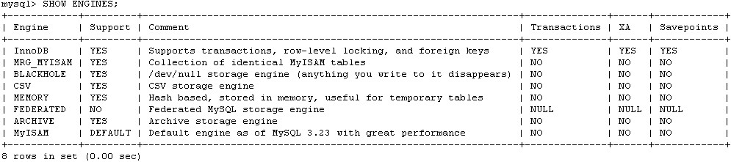
Specifying the Storage Engine for a Table
Every table is created using one of the storage engines supported by the server
The set of storage engines available depends both on how the server was compiled when it was built and on the options used at startup
To see which storage engines your server supports, use the SHOW ENGINES statement:

Slide 68
Specifying the Storage Engine for a Table
To specify a storage engine when you create a table, include an ENGINE = engine_name option in the CREATE TABLE statement:
  CREATE TABLE users (id INT) ENGINE = InnoDB;
The ALTER TABLE statement allows you convert a table from one storage engine to another:
  ALTER TABLE users ENGINE = MyISAM;
If a CREATE TABLE statement includes no ENGINE option, MySQL creates the table using the default storage engine, which is determined from the value of the storage_engine system variable

Slide 69
Set the default Engine
Specified at server startup with the --default-storage-engine option
For a running server, an administrator who has the SUPER privilege can change the default storage engine globally for all clients by setting the global storage_engine system variable:
  SET GLOBAL storage_engine = engine_name;
Any client can change its own default storage engine by issuing either of these statements:
  SET SESSION storage_engine = engine_name;
  SET storage_engine = engine_name;

Slide 70
Creating Tables Based on Existing Tables
MySQL provides two ways to create a table based on another table:
  CREATE TABLE ... SELECT creates a table and populates it from the result set returned by an arbitrary SELECT statement
    CREATE TABLE ... SELECT can create a table that is empty or non-empty, depending on what is returned by the SELECT part
  CREATE TABLE ... LIKE creates an empty table using the definition of another existing table
    result is a new table with a definition that includes all column attributes and indexes of the original table

Slide 71
The CREATE TABLE ... SELECT statement copies the column name and data type from the original table, but
  does not retain the PRIMARY KEY index information
  or the AUTO_INCREMENT column attribute information
The new table also uses the default storage engine, rather than the storage engine utilized by table t. The copy created with CREATE TABLE ... LIKE has none of these problems
Some table attributes are not copied, even when issuing CREATE TABLE ... LIKE. The most notable examples are:
  If the original table is a MyISAM table for which the DATA DIRECTORY or INDEX DIRECTORY table options are specified
  Foreign key definitions in the original table are not copied to the new table. If you wish to retain the foreign key definitions, they must be re-specified with ALTER TABLE after creating the copy

Slide 72
Using TEMPORARY Tables
TEMPORARY table differs from a non- TEMPORARY table in the following ways:
  It's visible only to the client that created it and may be used only by that client. This means that different clients can create TEMPORARY tables that have the same name and no conflict occurs
  A TEMPORARY table exists only for the duration of the connection in which it was created
  A TEMPORARY table may have the same name as a non-TEMPORARY table
  A TEMPORARY table can be renamed only with ALTER TABLE. You cannot use RENAME TABLE

Slide 73
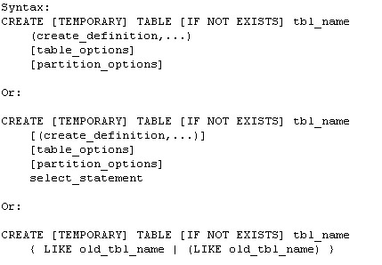
Summary of Creating tables

Slide 74
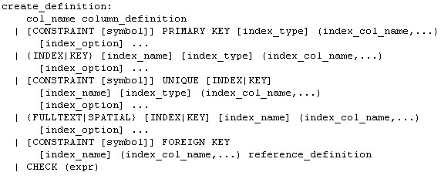

Slide 75
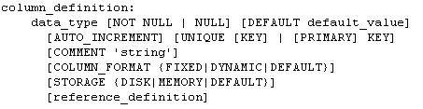
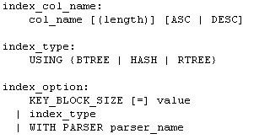

Slide 77
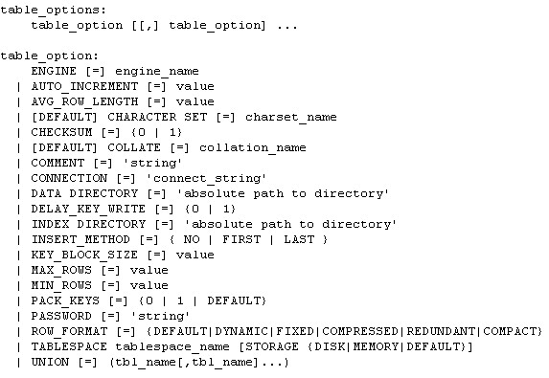

Slide 78
Altering Tables
To change a table "in place," use the ALTER TABLE statement
Some of the modifications to a table's structure that ALTER TABLE makes possible:
  Adding or dropping columns
  Changing the name or definition of a column
  Adding or dropping indexes
  Renaming the table

Slide 79
Adding and Dropping Columns
To add a new column to a table, use ALTER TABLE with an ADD clause that specifies the column's definition
A column definition uses the same syntax for ALTER TABLE as for CREATE TABLE
To indicate that MySQL should place the new column in a specific position within the table, append either the keyword FIRST or the keyword-identifier combination AFTER column_name to the column definition
  The FIRST keyword tells ALTER TABLE to place the new column before all existing columns (in the "first" position)
  Using AFTER column_name tells ALTER TABLE to place the new column after a specific existing column

Slide 80
Modifying Existing Columns
The first way to alter a column definition is to use a MODIFY clause
  ou must specify the name of the column that you want to change, followed by its new definition
The second way to alter a column definition is to use a CHANGE clause
  CHANGE enables you to modify both the column's definition and its name
    Specify the CHANGE keyword, followed by the column's existing name, its new name, and its new definition, in that order
    Must specify the existing name twice if you want to change only the column definition

Slide 81
Renaming a Table
Renaming a table changes neither a table's structure nor its contents
  ALTER TABLE old_name RENAME TO new_name;
Another way to rename a table is by using the RENAME TABLE statement:
  RENAME TABLE old_name TO new_name ;
RENAME TABLE can perform multiple table renames in a single operation
For TEMPORARY tables, RENAME TABLE does not work

Slide 82
Dropping Tables
To remove a table when you no longer need it, use the DROP TABLE statement:
  DROP TABLE t;
In MySQL, a single DROP TABLE statement can name several tables to be dropped simultaneously:
  DROP TABLE t1, t2, t3;
To prevent an error from occurring if a table does not exist when you attempt to drop it, add an IF EXISTS clause to the statement
  DROP TABLE t1 IF EXISTS;

Slide 83
insert into
delete

Slide 84
Indexes
A database index is a data structure that improves the speed of data retrieval operations on a database table at the cost of slower writes and increased storage space
Indexes can be created using one or more columns of a database table, providing the basis for both rapid random look ups and efficient access of ordered records
In a relational database, an index is a copy of one part of a table
Indexes may be defined as unique or non-unique
  A unique index acts as a constraint on the table by preventing duplicate entries in the index and thus the backing table

Slide 85
Types of Indexes
A primary key is an index for which each index value differs from every other and uniquely identifies a single row in the table
  A primary key cannot contain NULL values
A unique index is similar to a primary key, except that it can be allowed to contain NULL values
A non-unique index is an index in which any key value may occur multiple times
There are also more specialized types of indexes:
  A FULLTEXT index is specially designed for text searching
  A SPATIAL index applies only to columns that have spatial data types

Slide 86
Creating Indexes
You can create indexes at the same time that you create a table by including index definitions in the CREATE TABLE along with the column definitions
It is also possible to add indexes to an existing table with ALTER TABLE or CREATE INDEX

Slide 87
Defining Indexes at Table Creation Time
To define indexes for a table at the time you create it, include the index definitions in the CREATE TABLE statement along with the column definitions
An index definition consists of the appropriate index-type keyword or keywords, followed by a list in parentheses that names the column or columns to be indexed
A table can have multiple indexes
To create a unique-valued index, use the UNIQUE keyword instead of INDEX

Slide 88
PRIMARY KEY is similar to a UNIQUE index. The differences between the two are as follows:
  A PRIMARY KEY cannot contain NULL values; a UNIQUE index can. If a unique-valued index must be allowed to contain NULL values, you must use a UNIQUE index, not a PRIMARY KEY
  Each table may have only one index defined as a PRIMARY KEY. (The internal name for a PRIMARY KEY is always PRIMARY, and there can be only one index with a given name.) It's possible to have multiple UNIQUE indexes for a table
It follows from the preceding description that a PRIMARY KEY is a type of unique-valued index, but a UNIQUE index isn't necessarily a primary key unless it disallows NULL values

Slide 89
Naming Indexes
For all index types other than PRIMARY KEY, you can name an index by including the name just before the column list
If you don't provide a name for an index, MySQL assigns a name for you based on the name of the first column in the index
If you don't provide a name for an index, MySQL assigns a name for you based on the name of the first column in the index
Index names are displayed by the SHOW CREATE TABLE or SHOW INDEX statement

Slide 90
Adding Indexes to Existing Tables
To add an index to a table, you can use ALTER TABLE or CREATE INDEX
  To add an index to a table with ALTER TABLE, use ADD followed by the appropriate index-type keywords and a parenthesized list naming the columns to be indexed
Note that with CREATE INDEX, it's necessary to provide a name for the index. With ALTER TABLE, MySQL creates an index name automatically if you don't provide one

Slide 91
Dropping Indexes
To drop an index from a table, use ALTER TABLE or DROP INDEX
To drop another kind of index, you must specify its name. If you don't know the name, you can use SHOW CREATE TABLE to see the table's structure, including any index definitions
Dropping an index differs from dropping a database or a table, which cannot be undone except by recourse to backups. The distinction is that when you drop a database or a table, you're removing data. When you drop an index, you aren't removing table data, you're removing only a structure that's derived from the data

Slide 92
Querying for Data

Slide 93
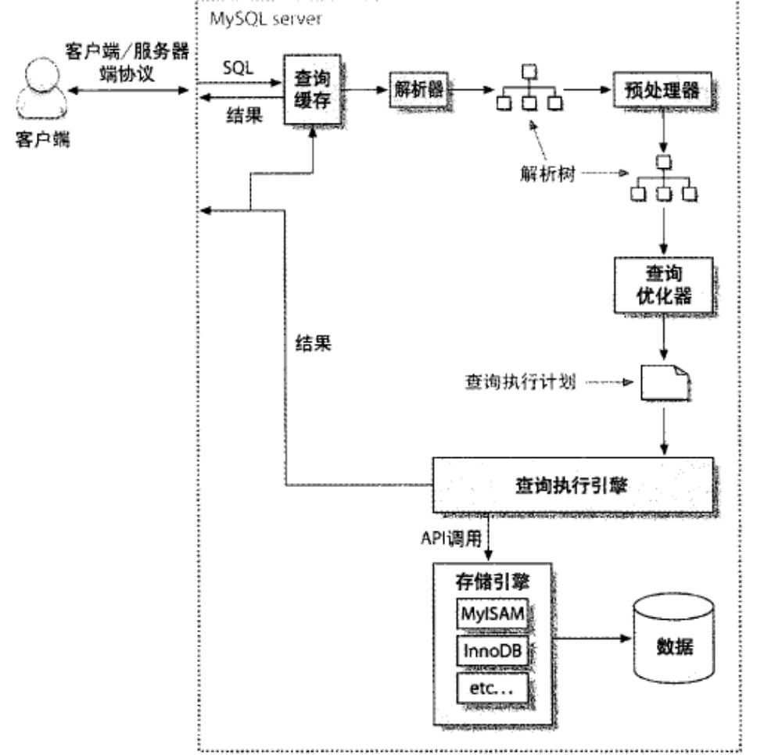
查询的执行路径

Slide 94
Using SELECT to Retrieve Data
SELECT values_to_display
FROM table_name
WHERE expression
GROUP BY how_to_group
HAVING expression
ORDER BY how_to_sort
LIMIT row_count;

Slide 95
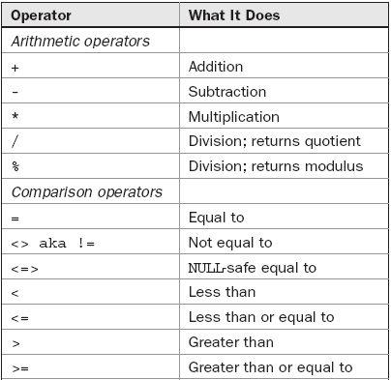
MySQL operators

Slide 96
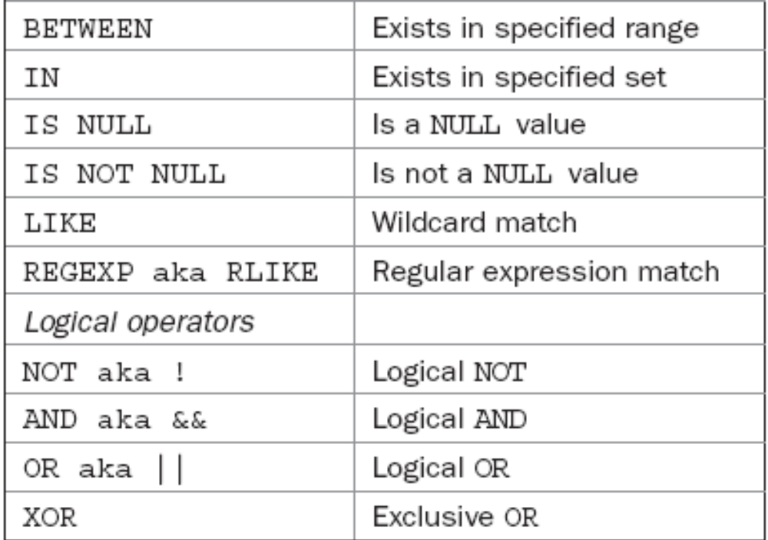

Slide 97
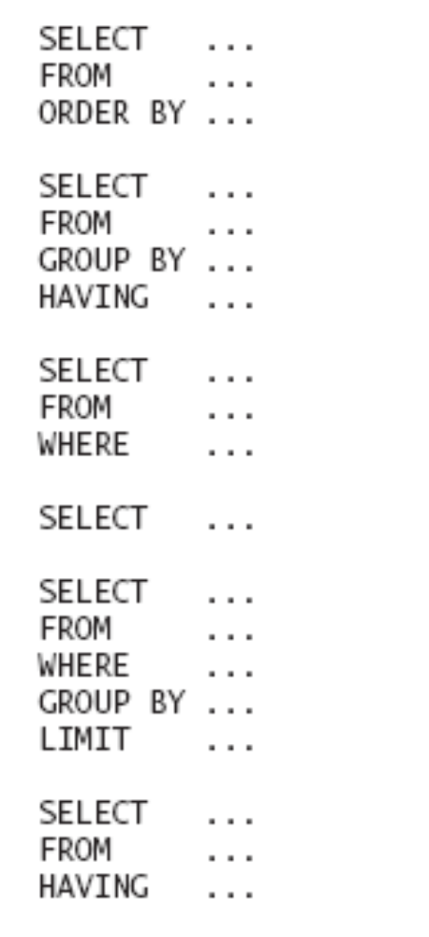

Slide 98
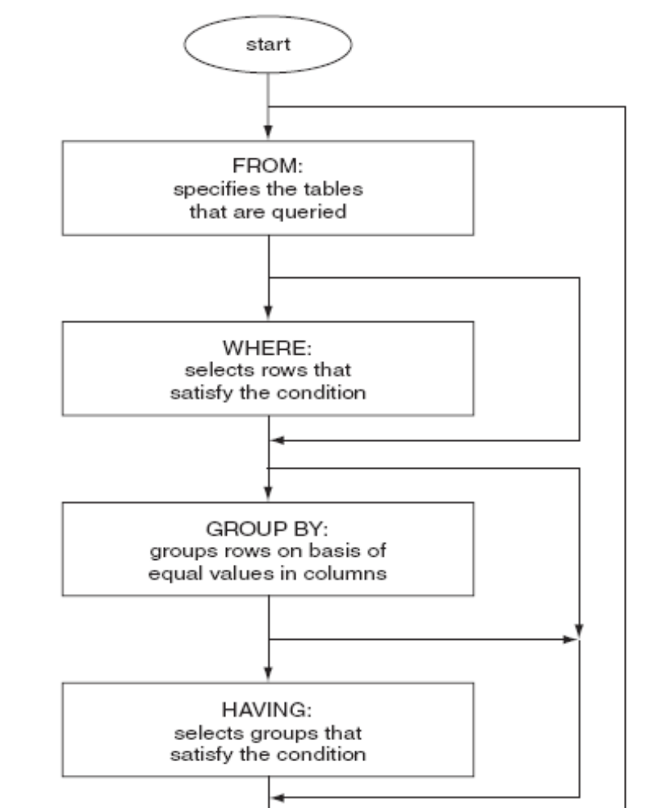
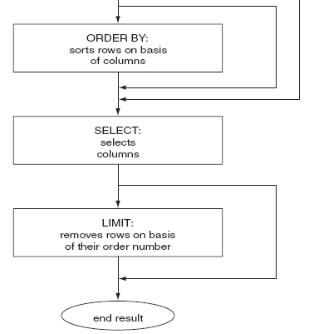
The clauses of the SELECT statement

Slide 99
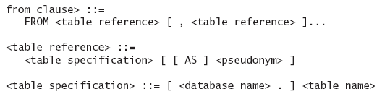
From clause

Slide 100
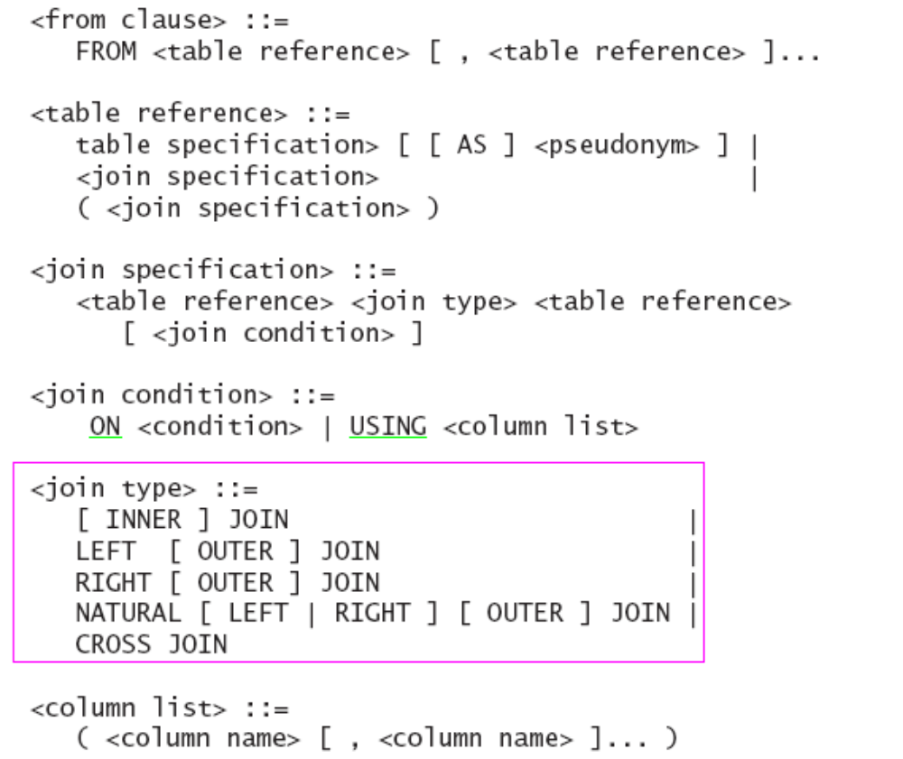
Join

Slide 101
Specifying Which Columns to Retrieve
To indicate what values to retrieve, name them following the SELECT keyword
To select information from a table, it's necessary to identify the table by adding a FROM table_name clause following the list of columns to retrieve
For a SELECT operation that retrieves every column from a table, the shortcut * can be used to specify the output columns

Slide 102
Renaming Retrieved Columns
Output column names, by default, are the same as the column or expression selected. To rename a column, provide an alias following the column in the output list:
  Columns aliases are used as follows:
    The keyword AS is optional
    An alias may be quoted. If it consists of multiple words, it must be quoted
    You can refer to a column alias elsewhere in the query, in the GROUP BY, HAVING, or ORDER BY clause. However, you cannot refer to aliases in the WHERE clause

Slide 103
Identifying the Database Containing a Table
When you name a table in a SELECT statement, it's normally assumed to be a table in the default database
If there's no default database, the statement results in an error because MySQL cannot tell where to find the table
To specify a database explicitly in the SELECT statement itself, qualify the table name. That is, precede the table name with the database name and a period
The database name acts as a qualifier for the table name. It provides to the server a context for locating the table. Qualified table names are useful under several circumstances:
  When there's no default database. In this case, a qualifier is necessary for accessing the table
  When you want to select information from a table that's located somewhere other than the default database
  When you aren't sure what the default database is

Slide 104
Specifying Which Rows to Retrieve
To be more specific about which rows are of interest, include a WHERE clause that describes the characteristics of those rows
A WHERE clause can be as simple or complex as necessary to identify the rows that are relevant for your purposes
  More complex WHERE clauses specify multiple conditions, which may be combined using logical operators such as AND and OR
  For testing values in a range, you can also use the BETWEEN operator
  Some operators have higher precedence than others. For example, AND has a higher precedence than OR. To control the order of evaluation of terms within a complex expression (or simply to make the evaluation order explicit), use parentheses to group expression terms

Slide 105
Using ORDER BY to Sort Query Results
By default, the rows in the result set produced by a SELECT statement are returned by the server to the client in no particular order. When you issue a query, the server is free to return the rows in any convenient order
If you require output rows to be returned in a specific order, include an ORDER BY clause that indicates how to sort the results
  You can name one or more columns, separated by commas, to use for sorting
  ASC for ascending, DSC for descending

Slide 106
Limiting a Selection Using LIMIT
MySQL supports a LIMIT clause in SELECT statements, which tells the server to return only some of the rows selected by the statement
LIMIT may be given with either one or two arguments:
  LIMIT row_count
  LIMIT skip_count, row_count
    Each argument must be given as an integer constant
    You cannot use expressions, user variables, and so forth
It's often helpful to include an ORDER BY clause to put the rows in a particular order when you use LIMIT
The UPDATE and DELETE statements also support the use of LIMIT, which causes only a certain number of rows to be updated or deleted

Slide 107
Using DISTINCT to Eliminate Duplicates
If a query returns a result that contains duplicate rows, you can remove duplicates to produce a result set in which every row is unique
To do this, include the keyword DISTINCT after SELECT and before the output column list
DISTINCT treats all NULL values within a given column as having the same value
Duplicate elimination for string values happens differently for non-binary and binary strings. If they are non-binary strings, they are considered distinct if they have different values based on their collation

Slide 108
Aggregating Results
Use aggregate functions to calculate summary values, possibly combined with a GROUP BY clause to arrange the selected rows into groups so that you can get summaries for each group
Grouping can be based on the values in one or more columns of the selected rows
Several types of aggregate functions:
  MIN() and MAX() find smallest and largest values
  SUM() and AVG() summarize numeric values to produce sums (totals) and averages
  COUNT() counts rows, values, or the number of distinct values
  GROUP_CONCAT() concatenates a set of strings to produce a single string value
Aggregate functions may be used with or without a GROUP BY clause that places rows into groups

Slide 109
The GROUP_CONCAT() Function
The purpose of the GROUP_CONCAT() function is to concatenate column values into a single string
This is useful if you would otherwise perform a lookup of many rows and then concatenate them on the client end
GROUP_CONCAT() supports several modifiers:
  The default string separator used by GROUP_CONCAT() is ',' (comma). To change the separator, use a SEPARATOR clause
    SELECT GROUP_CONCAT(name SEPARATOR ‘-’) AS EMPLOYEE WHERE dep=‘market’;
  GROUP_CONCAT() adds strings to the result in the order in which the database server reads them. To change the concatenation order, add an ORDER BY clause

Slide 110
Selecting Groups with HAVING
It could be when you use GROUP BY that you're interested only in groups that have particular summary characteristics
To retrieve just those groups and eliminate the rest, use a HAVING clause that identifies the required group characteristics
HAVING acts in a manner somewhat similar to WHERE, but occurs at a different stage of query processing
  WHERE, if present, identifies the initial set of records to select from a table
  GROUP BY arranges the selected records into groups
  Aggregate functions compute summary values for each group
  HAVING identifies which groups to retrieve for the final result set

Slide 111
Using UNION
The UNION keyword enables you to concatenate the results from two or more SELECT statements. The syntax for using it is as follows:
  SELECT ... UNION SELECT ... UNION SELECT ...

Slide 112
MySQL Language Structure
Some important rules about the language structure in MySQL:
  Comments and portability
  Case-sensitivity
  Escape characters
  Naming limitations
  Quoting
  Time zones
  Character sets and collations

Slide 113
Comments and portability
One of the cleverest MySQL extensions to the SQL standard is actually a way to manage portability
MySQL has an extension that specifies a MySQL version as part of a comment
  The comment will be only parsed if the mysqld server is of an appropriate version; otherwise, the comment will be left as a comment and ignored by other databases and mysqld versions
-- : the standard SQL simple comment introducer
/* */ : allow partial line and multi-line commenting
/*! */ : MySQL specific code, and the mysqld server will parse it

Slide 114
Case-sensitivity
In general, mysqld is case-insensitive with respect to names of fields, indexes, stored routines and events
Case-sensitivity for names is determined by whether or not the file system is case-sensitive for the following:
  Databases
  Tablespaces
  Tables
  Views
  Aliases
  Triggers
  Log file groups

Slide 115
Escape characters
The escape character is the backslash (\)
An escape sequence is a backslash followed by one character
  \\ to print the \ character.
  \’ to print the ’ character, even if the string is quoted with ’.
  \" to print the " character, even if the string is quoted with ".
  \_ prints the _ character. This can be used to search for the actual value when using LIKE. If _ is not escaped, it is used as the wildcard character for one character.
  \% prints the % character. This can be used to search for the actual value % when using LIKE. If % is not escaped, it is used as the wildcard character for one or more characters.
  \b prints a backspace character
  \r and \n print a carriage return and a new line, respectively
  \t prints a tab separator
  \0 and \Z print ASCII 0 (NUL) and ASCII 26 (Ctrl-Z), respectively. In Windows, Ctrl-Z is a special character marking an end of a file, and on Mac OS X and Unix, Ctrl-Z is the special key sequence that will suspend the current foreground process.

Slide 116
Naming limitations and quoting
Identifiers are names of: databases, tables, views, fields, indexes, tablespaces, stored routines, triggers, events, servers, log file groups, and aliases (specified with the AS keyword).
Identifiers are all limited to 64 characters except aliases, which are limited to 255 characters
Identifiers can be almost anything. However, identifiers may not end with one or more spaces
Identifier names can be reserved words or numbers, and include punctuation. However, to be parsed correctly, such identifiers need to be quoted
On the other hand, numbers will be parsed as numbers. In order to parse a number as an identifier, it must be quoted

Slide 117
Modifying SELECT Behavior
SQL_CACHE SQL_NO_CACHE
SQL_BUFFER_RESULT
SQL_HIGH_PRIORITY

Slide 118
Viewing Database, Table, and Field Information
SHOW CREATE TABLE
SHOW INDEX
SHOW ENGINES
SHOW PROCESSLIST
SHOW ERRORS
SHOW WARNINGS
SHOW STATUS
SHOW TABLE STATUS
SHOW CHARACTER SET
SHOW COLLATION

Slide 119
Index and View

Slide 120
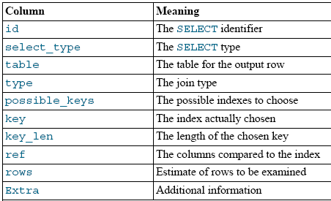
Explain
id
  The SELECT identifier. This is the sequential number of the SELECT within the query.

Slide 121
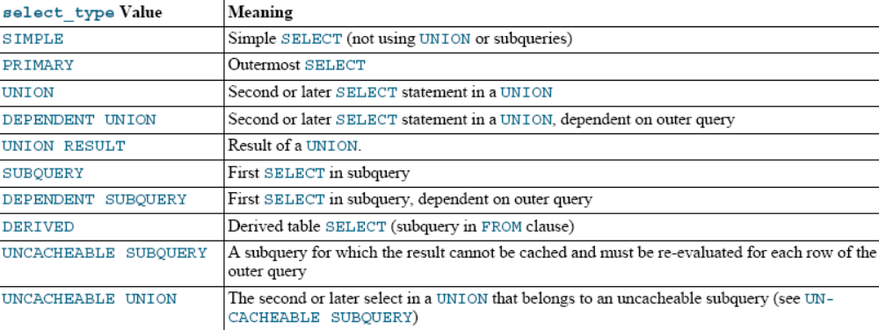
select_type

Slide 122
table
  The table to which the row of output refers.
type
  The join type
    system
      The table has only one row (= system table)
    const
      The table has at most one matching row, which is read at the start of the query
    eq_ref
      One row is read from this table for each combination of rows from the previous tables
      Other than the system and const types, this is the best possible join type
      It is used when all parts of an index are used by the join and the index is a PRIMARY KEY or UNIQUE NOT NULL index

Slide 123
  The join type
    ref
      All rows with matching index values are read from this table for each combination of rows from the previous tables
    index
      This join type is the same as ALL, except that only the index tree is scanned
    ALL
      A full table scan is done for each combination of rows from the previous tables

Slide 124
possible_keys
  The possible_keys column indicates which indexes MySQL can choose from use to find the rows in this table
key
  The key column indicates the key (index) that MySQL actually decided to use
  If MySQL decides to use one of the possible_keys indexes to look up rows, that index is listed as the key value
key_len
  indicates the length of the key that MySQL decided to use

Slide 125
ref
  shows which columns or constants are compared to the index named in the key column to select rows from the table
rows
  Indicates the number of rows MySQL believes it must examine to execute the query
filtered
  Indicates an estimated percentage of table rows that will be filtered by the table condition

Slide 126
Extra
  Contains additional information about how MySQL resolves the query
  Using index
    The column information is retrieved from the table using only information in the index tree without having to do an additional seek to read the actual row
  Using temporary
    To resolve the query, MySQL needs to create a temporary table to hold the result
    This typically happens if the query contains GROUP BY and ORDER BY clauses that list columns differently
  Using where
    A WHERE clause is used to restrict which rows to match against the next table or send to the client

Slide 127
  Using filesort
    MySQL must do an extra pass to find out how to retrieve the rows in sorted order

Slide 128
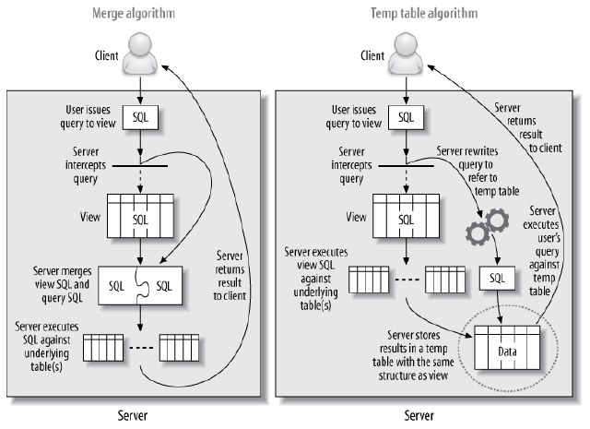
Two implementations of views

